Slide 1
Introduction to Big Data with Apache Spark

Slide 2
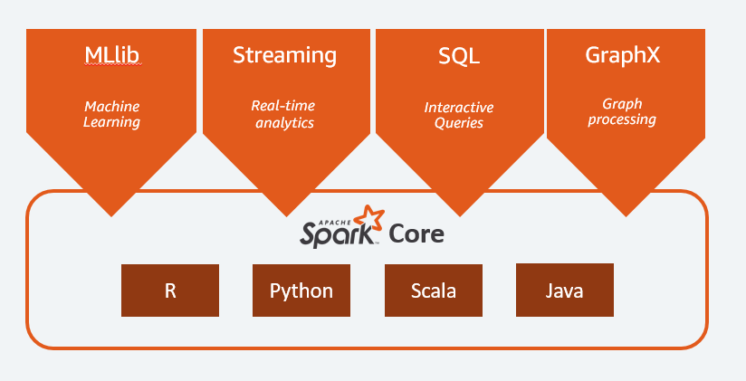

Slide 3
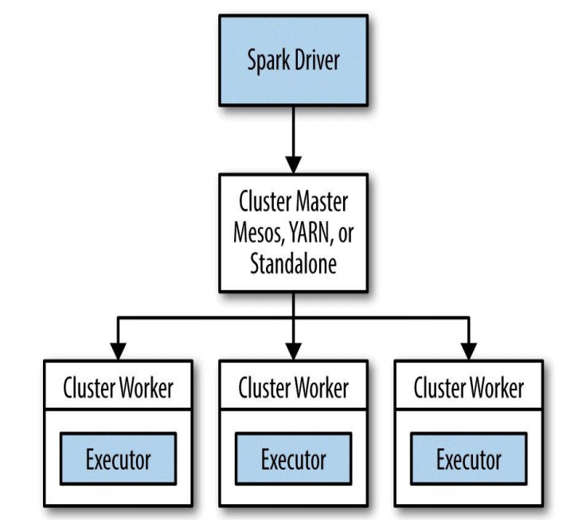

Slide 4
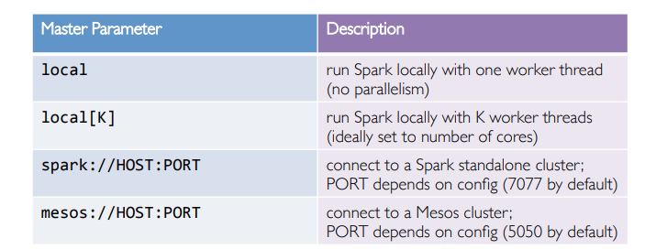
SparkContext

Slide 5
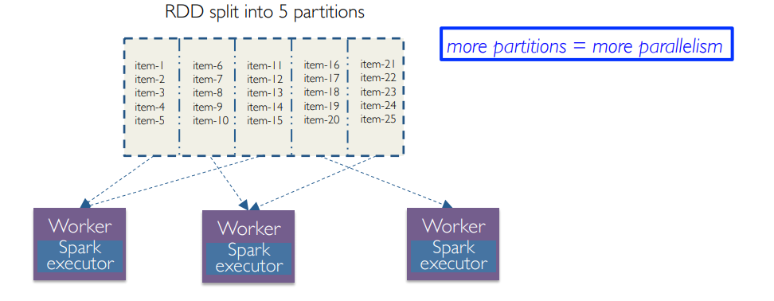
RDD

Slide 6
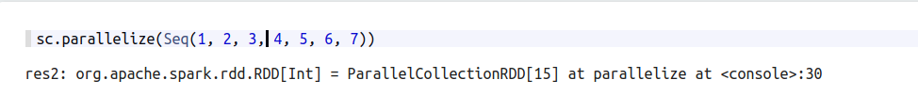
Operation with RDD
Трансформации (lazy)
Действия

Slide 7
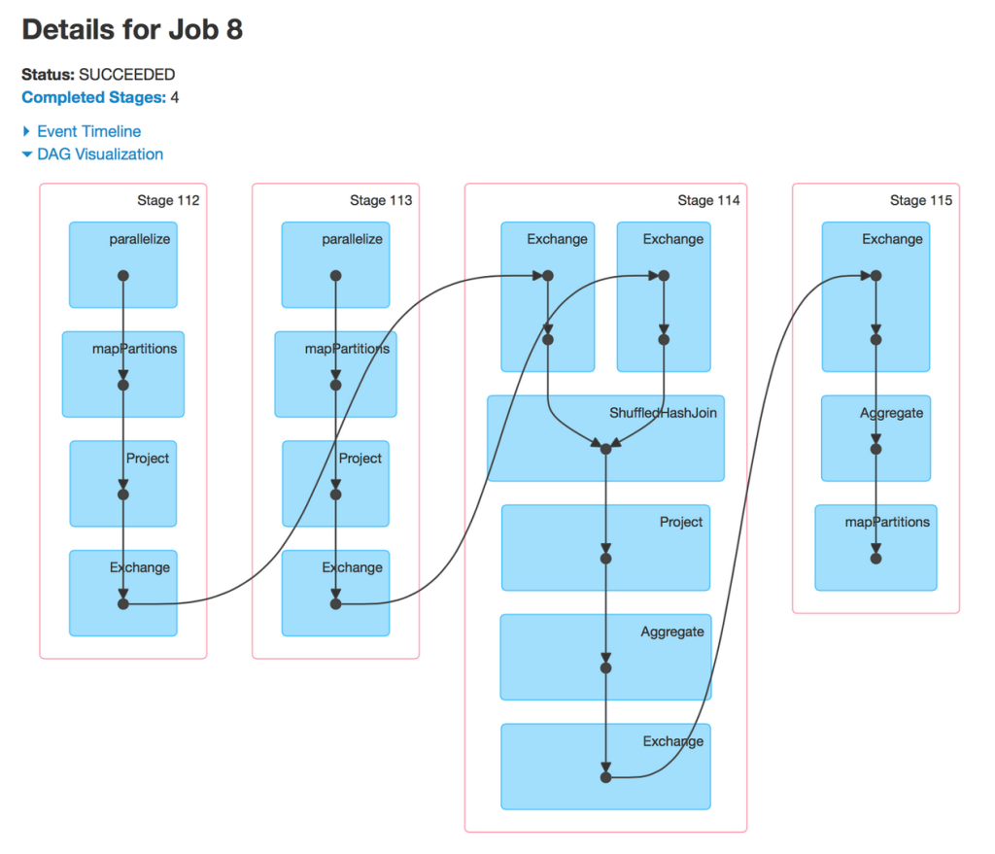
Transformation

Slide 8
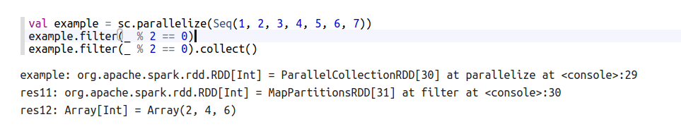
filter

Slide 9
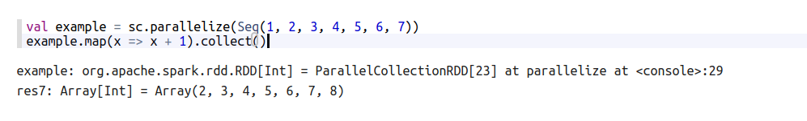
Map

Slide 10
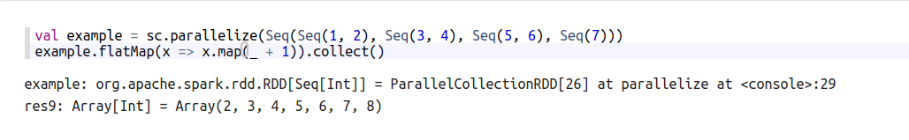
flatMap

Slide 11
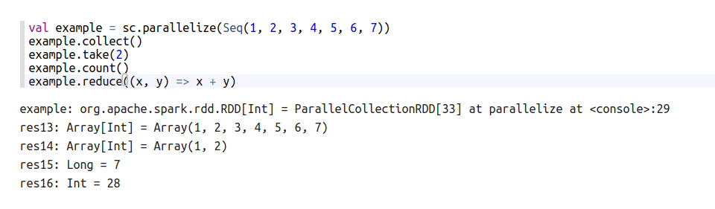
Action

Slide 12
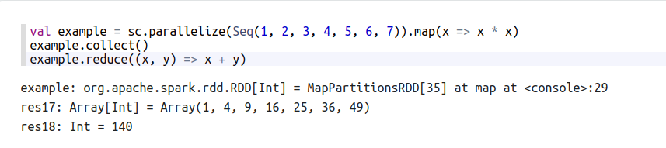
Prevent double computing

Slide 13
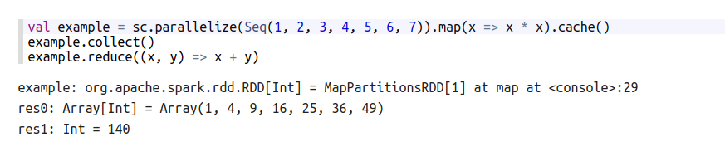
Cache

Slide 14
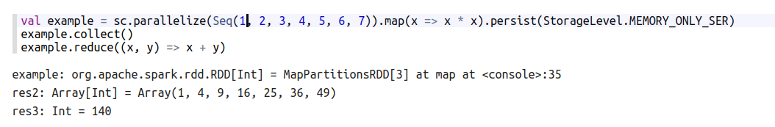
Persist

Slide 15
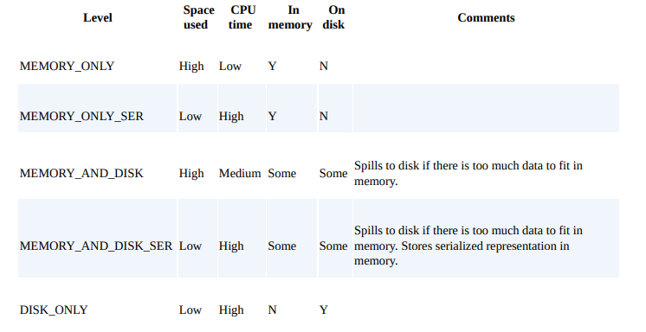

Slide 16
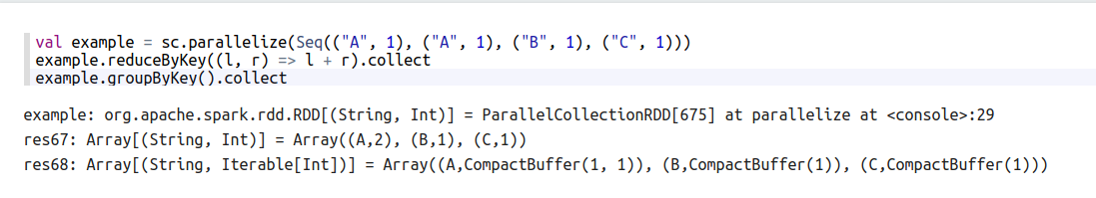
Key-value

Slide 17
Shared variables
Broadcast variables
Accumulators

Slide 18
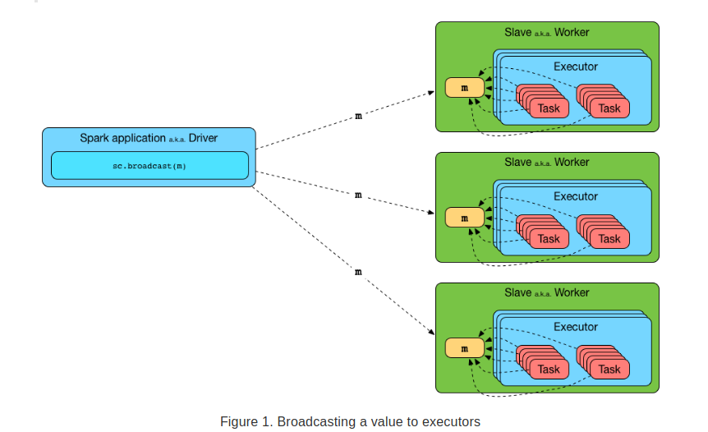
Broadcast variable

Slide 19
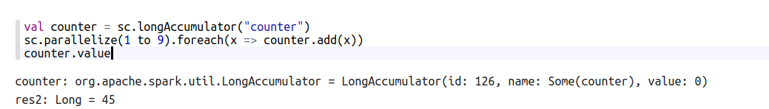
Accumulators

Slide 20
Guarantees
Tasks at workers cannot access accumulator’s values
Tasks see accumulators as write-only variables
Actions: each task’s update to accumulator is applied only once
Transformations: no guarantees (use only for debugging)
Types: integers, double, long, float

Slide 21
Thanks!

